Slide 1
Google, AI and Home Automation
Kiran Kaja (kkaja@google.com)

Slide 2
Google’s Mission
“Organize the world's information and make it universally accessible and useful.”
Access to information & technology can have profound impact on lives of disabled people

Slide 3
Accessibility Makes Business Sense
Over 1.3 billion disabled people in the world
2.4 billion people including immediate friends & family
Disabled people outnumber hispanic & 8-14 year olds in the US
Control over potentially $8 Trillion of annual disposable income

Slide 4
Accessibility Benefits Everyone
Good contrast between text and background helps low vision users
But also makes it easier to read in the sunlight for everyone
Robust eyes-free voice interface helps blind & motor impaired users
But also makes everyone multitask better
e.g. Listen to your agenda for tomorrow while changing your baby
Accessibility problems of yesterday are mainstream breakthroughs of today e.g.
Auto complete & speech recognition: designed to make it easier for disabled people to use computers
Flatbed scanner, Optical Character Recognition & TTS: designed to help blind people read printed material

Slide 5
AI First Approach
Contextual information
Machine learning
using intelligent technology to improve customer experience

Slide 6
AI and ML Is Everywhere
Speech recognition
Text to speech
Computer vision
Predictive text

Slide 7
Practical Uses of AI
Search and sort photos in Google Photos
Youtube auto captions (including background sounds)
Gmail suggested replies

Slide 8
AI and Accessibility
Automatic language switching with TTS in Android O
Face recognition in Android Camera app

Slide 9
Introducing Google Assistant
Meet your Google Assistant. Ask it questions. Tell it to do things. It’s your own personal Google, always ready to help.
Google Home: voice-activated speaker powered by the Google Assistant
Google Pixel 2: The phone with the Google Assistant built in.
To start, just say “Ok Google” or touch and hold the Home button Or squeeze. With Talkback running, double tap and hold the Home button.
Things that Google Assistant can do include:
Send messages - Text Maya "see you in 5"
Set Reminders: Remind me to do laundry when I get home
Daily briefing: Tell me about my day
Flights: When is my flight to Chicago?
Restaurant reservations: Reserve a table at Quartino
Photos: Show my photos of sunsets/ Photos: Take a selfie
Music: Play some jazz
Control your smart home devices
And much more...

Slide 10
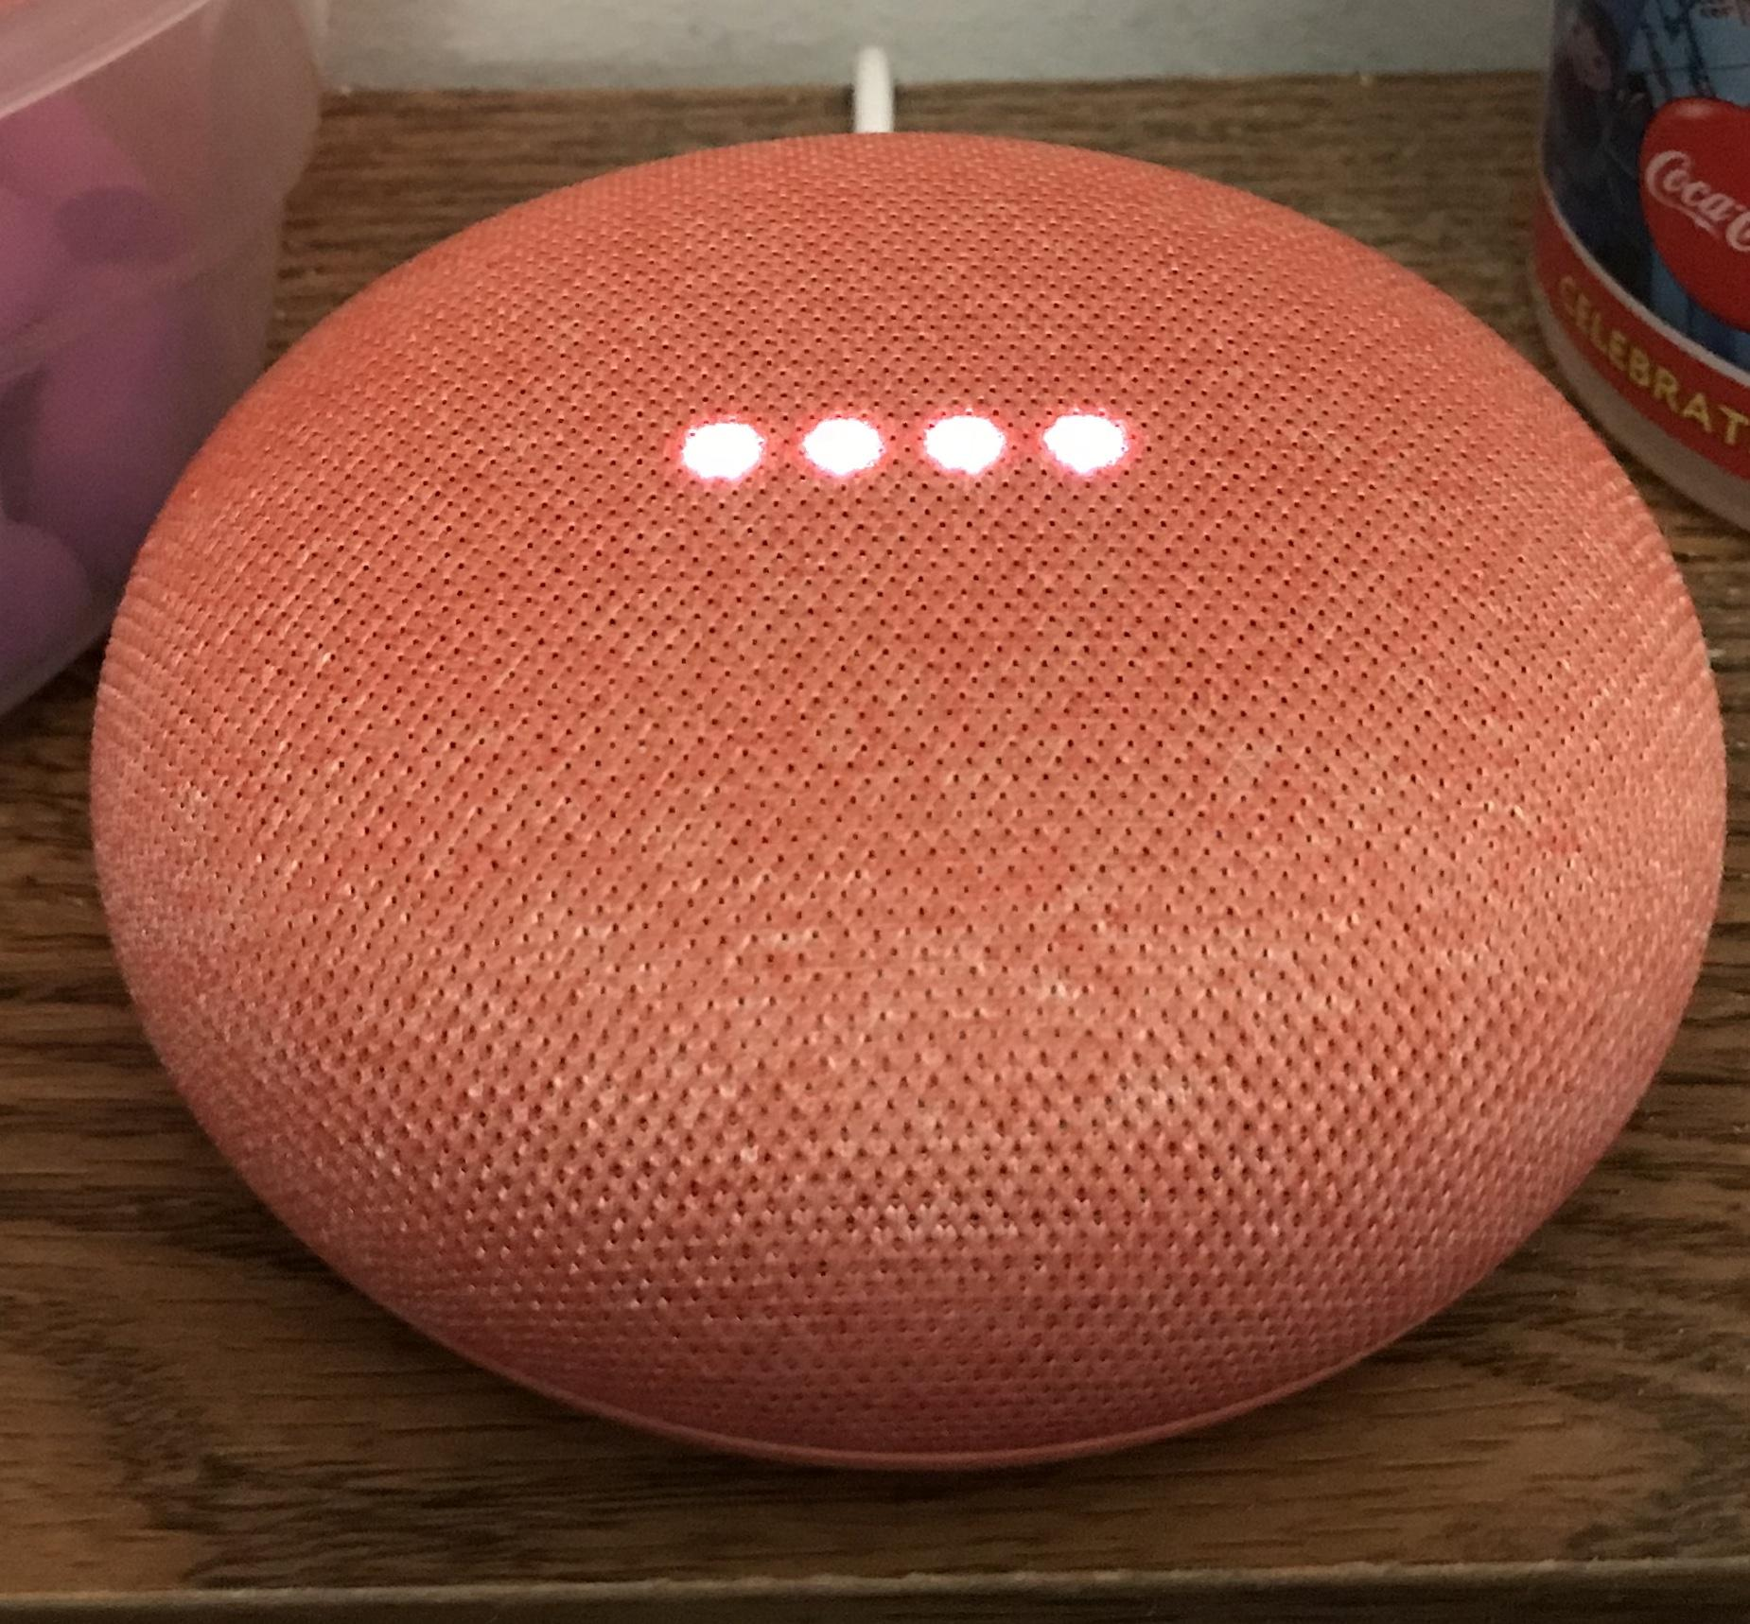
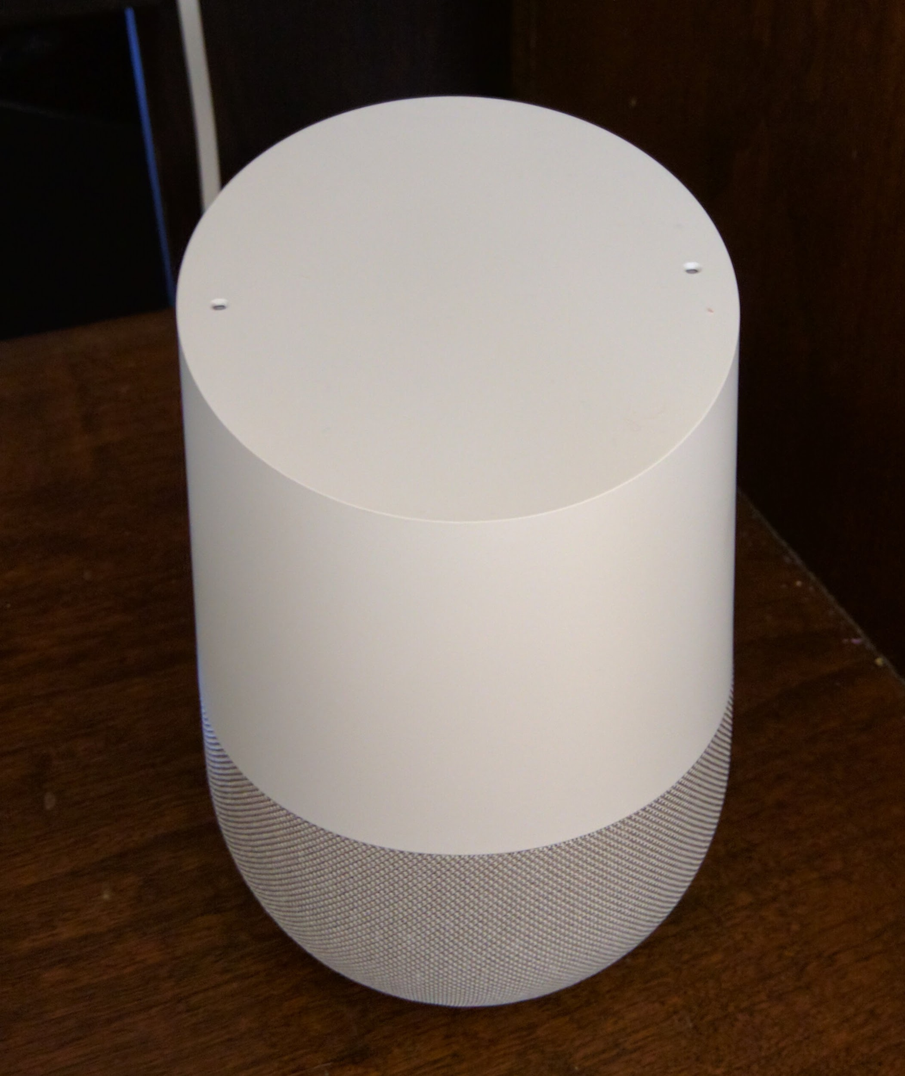
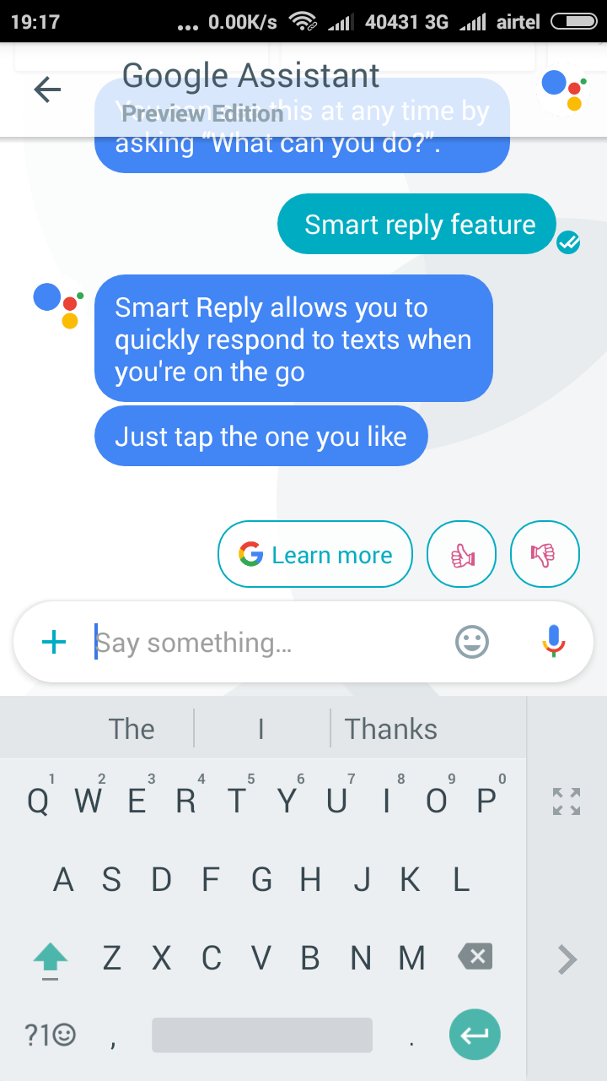
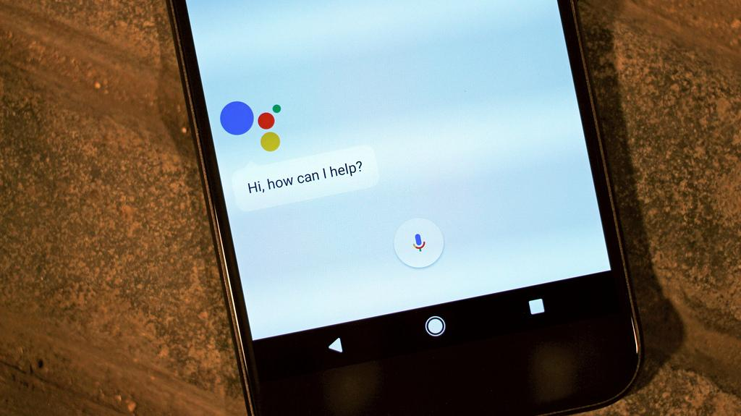
All your devices. One Assistant.
Meet your Google Assistant on
Google Home/Home Mini
3p speakers from Sony, JBL, etc
Pixel/Pixel 2, a phone by Google
Android devices running Android Marshmallow and above
iOS devices via Google Assistant app
Android TV
Google Allo
Android Wear

Slide 11
Discover What You Can Do
Just say “Ok Google, what can you do?” or
Go to the Explore tab in the Assistant app
Icon in the top right corner

Slide 12
Accessibility Meets Usability: Enable Microphone Beeps
Google Home can play audio beeps when you say “Ok Google” and when you stop speaking.
Go to the Google Home app > Main Menu/hamburger menu > Devices > [your device] Settings > Accessibility and enable the options you want.
Intended primarily as an accessibility feature but used by a large number of regular users too

Slide 13
Accessibility Meets Usability: Typing Mode
Chat with Assistant by typing
Android and iOS
Essential for speech and hearing impaired users
But also useful for everyone in public spaces

Slide 14
Hands-free and Eyes-free Control for Smart Devices
Google Assistant works with 150+ smart home brands and controls 1000+ products
Just use your voice to control a range of devices around your home:
Thermostats
Lights
Plugs or switches
Locks
Home appliances e.g. washers, dryers, vacuums and ovens (coming soon)

Slide 15
Thermostats
“Ok Google, Make it warmer/cooler.”
“Ok Google, "Set the temperature to 72.”
“Ok Google, Turn on the heat/cooling.”
“Ok Google, what is the living room temperature?”

Slide 16
Lights
“Ok Google, turn on/off kitchen light.”
“Ok Google, dim the living room lights.”
“Ok Google, turn off all lights.”
“Ok Google, are the bedroom lights on?”

Slide 17
Plugs or Switches
“Ok Google, turn on/off living room fan.” (Fan needs to be plugged into a smart plug).

Slide 18
Multi Room Support
Create rooms within Google Assistant > Home Control settings.
Add smart devices to rooms and control them as a group.
“Ok Google, turn off bedroom lights.”

Slide 19
Home Control In Action

Slide 20
References
google.com/accessibility
google.com/assistant

