Slide 1
AUTISM AND ACCESSIBILITY Design Challenges and Solutions
Dafydd Henke-Reed, AbilityNet
TechShare Pro
23 November 2017

Slide 2
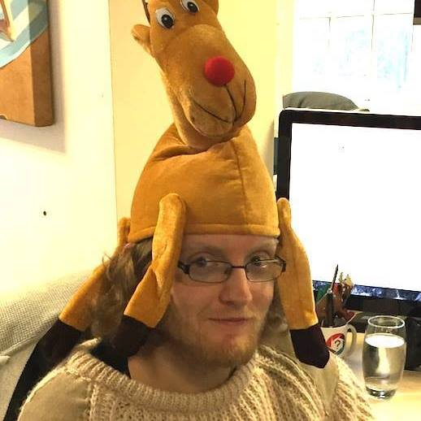
Welcome
Dafydd Henke-Reed
Principal Accessibility and Usability Consultant
AbilityNet

Slide 3
What is autism?
NHS
“Autism spectrum disorder (ASD) is an umbrella term for a range of conditions … that affects social interaction, communication, interests and behaviour”
National Autistic Society
“Autism is a lifelong developmental disability that affects how people perceive the world and interact with others”

Slide 4
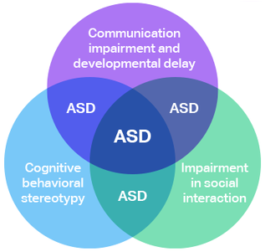
Common Symptoms of Autism
Social anxiety / impairment
Obsessive interests
Ritualistic behaviour (stimming)
Sensory sensitivity (photophobia)
NHS : ~1 in 100 people = 700,000 in UK
CDC observes growing childhood diagnosis
1 in 150 (2000) to 1 in 68 (2012).
4.5 times more common in boys
Notes:
Intellectual disability has strong comorbidity. But would require a talk entirely dedicated to it.

Slide 5
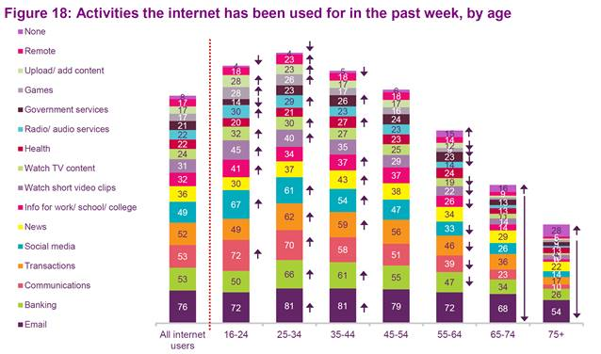
Why Autism Needs Considering
Desktop web is:
social e.g. Facebook
sensory e.g. YouTube
Most popular uses of the internet are social e.g. gaming and MOBAs

Slide 6
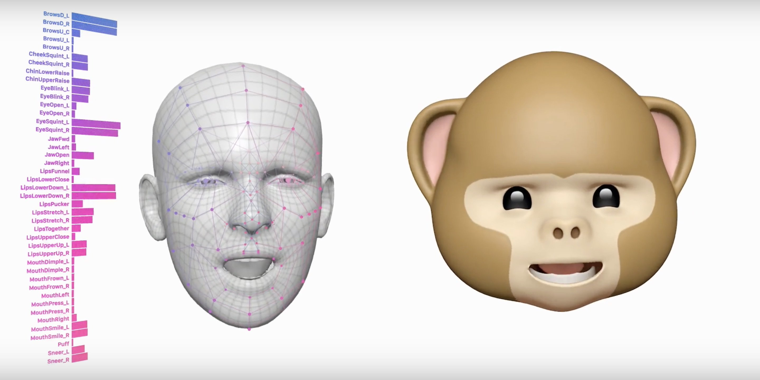
Why Autism Needs Considering
Communication innovations with mobile
e.g. expression-based comms (animojis)

Slide 7
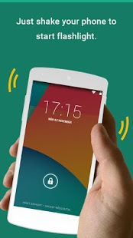
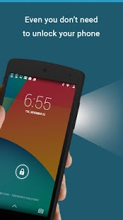
Accessibility and Autism Today
Websites which automatically present sensory information – e.g. YouTube –which would fail Audio Control (A)
Devices that cannot be used with stimming – e.g. a flashlight app that automatically activates when shaking phone.

Slide 8
Accessibility and Autism Tomorrow
Two areas of impairment and technologies.
Strengths, weakness, and design considerations.
Anxiety therapy—Blue Room
Emotion agnosia—Seeing AI

Slide 9
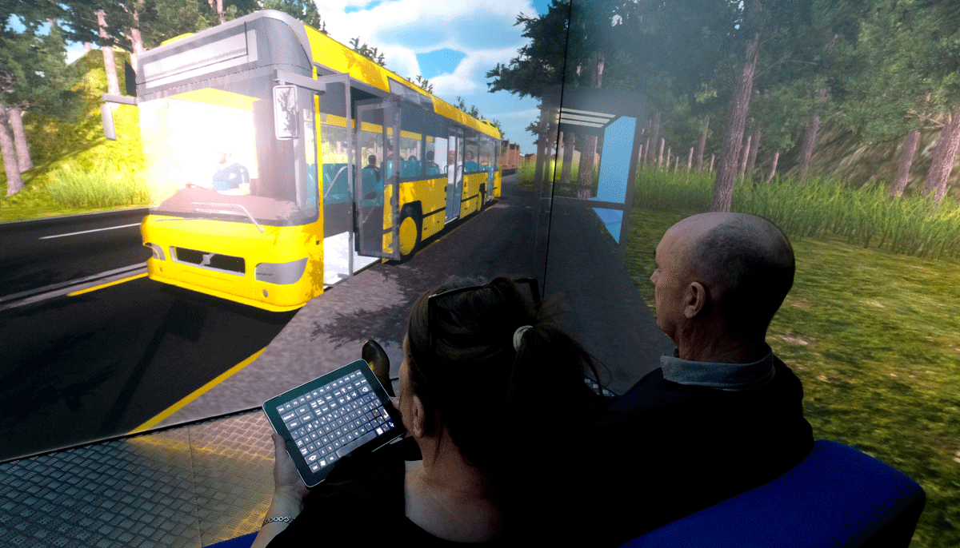
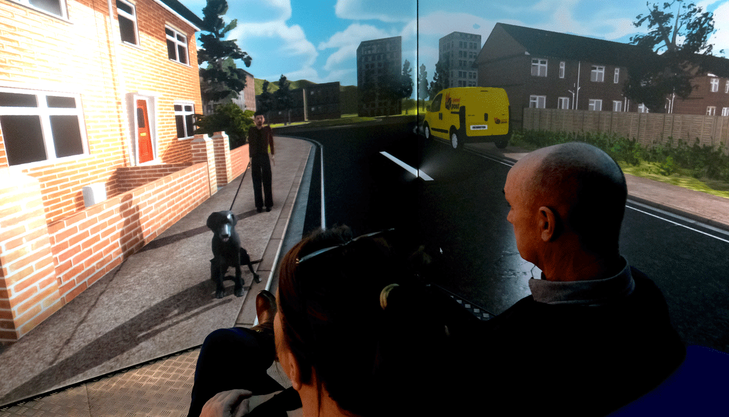
Blue Room – Newcastle University & NHS
AR / VRE environment helping children with autism overcome fears and phobias:
‘Current treatment is CBT but that often doesn’t work… it relies on their imagination’.
‘They move around the scene using iPad controls - interacting and navigating as they wish allowing them to fully control the environment.’

Slide 10
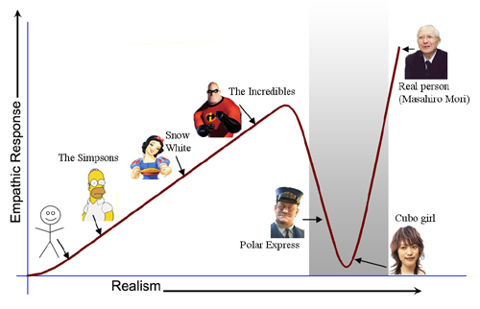
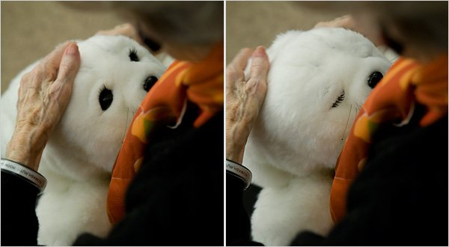
Autism & Simulation
Realism may not be amenable to those with autism. They may prefer the uncanny over the realistic.

Slide 11
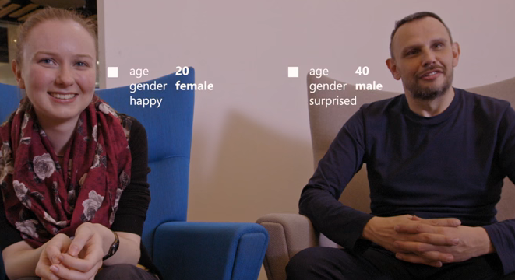
Seeing AI – Microsoft
Wearable prototype with emotion recognition—informed by machine learning

Slide 12
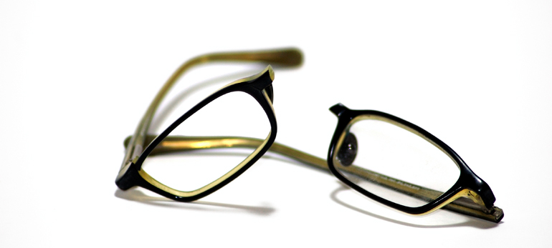
Autism & Wearables
People with ASD are six times more likely to show self-injury*
*FROM: The association between self-injurious behaviors and autism spectrum disorders Minshawi et al (2014)
Behaviours include:
head banging
face or head slapping or punching
forceful head shaking

Slide 13
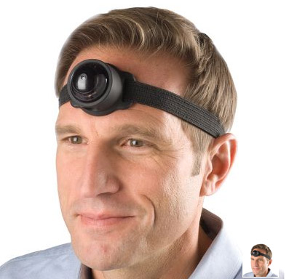
Autism & Wearables
Trying to help those social anxiety with technology attached to their faces.
Visible assistive technology – be it low or high-tech – can be a statement (e.g. a symbol cane).

Slide 14
Takeaways
Basics of autism - symptoms and stats
Current accessibility concerns
Future accessibility tech - therapies and tools
Tech can be a boon for treatment
The bleeding-edge may not be autism-friendly
Tools may promote fruitful dialogue
Robust, subtle, and / or be accepted as a statement by the Aspie community
The tech discussed seeks to help people with autism be more normal. We haven’t talked about tech that helps neurotypical people understand autism.

Slide 15
Thank you ❤
😊
Dafydd Henke-Reed
Dafydd.henke-reed@abilitynet.org.uk

Slide 16
References
NHS - Autism Spectrum Disorder - https://www.nhs.uk/conditions/autism/
NAS - What is Autism - http://www.autism.org.uk/about/what-is.aspx
CDC ASD Data & Stats - https://www.cdc.gov/ncbddd/autism/data.html
Ofcom - Adult Media Use - https://www.ofcom.org.uk/research-and-data/media-literacy-research/adults/adults-media-use-and-attitudes
University of Hertfordshire – KASPER – http://www.herts.ac.uk/about-us/case-studies/research-and-innovation/kaspar-the-social-robot-helping-children-with-autism-to-communicate
NCU - Blue Room -http://www.ncl.ac.uk/press/news/2017/02/blueroomautismnhs treatment/
Microsoft – Seeing AI - https://www.microsoft.com/en-us/seeing-ai/
Stanford University – Autism Google Glass Project - http://autismglass.stanford.edu/
Association between SIB and ASD - https://www.ncbi.nlm.nih.gov/pubmed/24748827
RNIB – The Cane Explained – https://www.youtube.com/watch?v=69gDygNlP0c
Cambridge University – Autism Research Centre - https://www.autismresearchcentre.com/

Slide 17
References
Which terms should be used to describe autism? Perspectives from the UK autism community - https://altogetherautism.org.nz/wp-content/uploads/2015/10/2015-Kenny-terms-to-describe-autism.pdf

